Slide 1

Progress Report
http://en.wikipedia.org/wiki/File:Volkswagen_logo.svg
Volkswagen Driving Simulator
Michael Fuller, Dirk Hortensius, Zach Roberts
Notes:
Zach will do Intro and pages 2-4

Slide 2
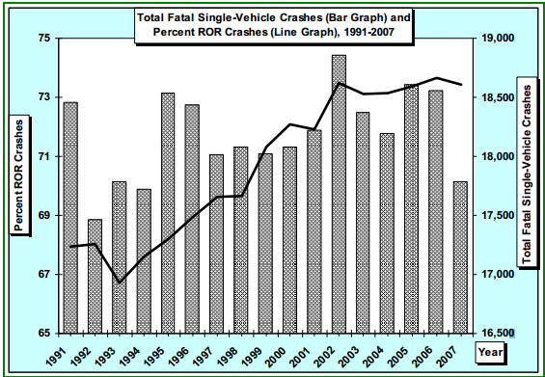
Over 17,000 fatal single-car accidents occurred every year from 1991-2007
Liu, C. and Submaranian, R. (2009) “Factors Related to Fatal Single-Vehicle Run-Off-Road Crashes”, DOT HS 811 232

Slide 3
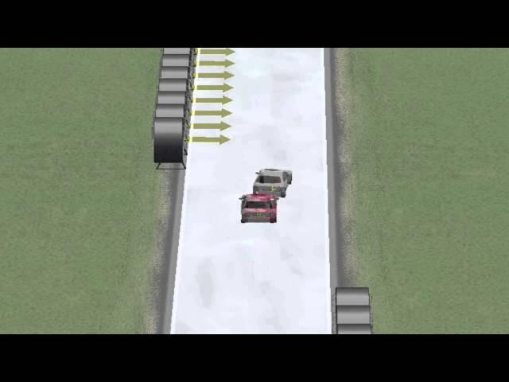
Goals of the Project
Long Term Goals
Develop a Driving Simulator to showcase predictive driving correction software
Short Term Goals
Create a multimedia presentation to present project to Volkswagen
Create an immersive driving simulator using the Matlab vehicle model.

Slide 4
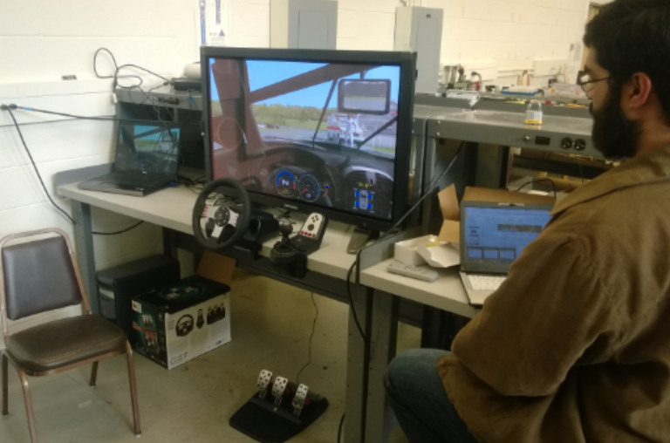
Client’s Requirements
Must be interactive.
Must support MATLAB.
Must be portable.

Slide 5
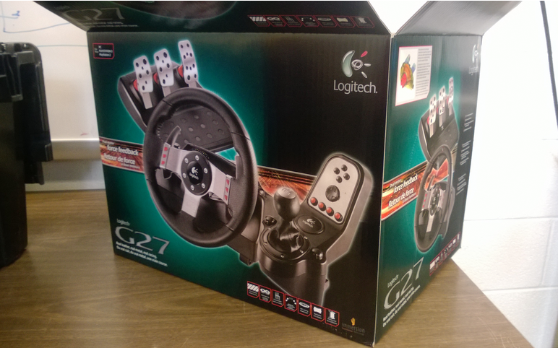
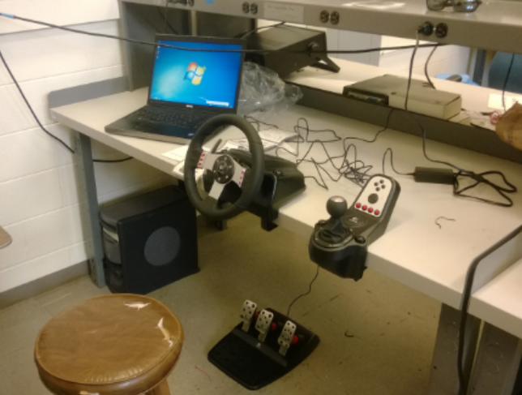
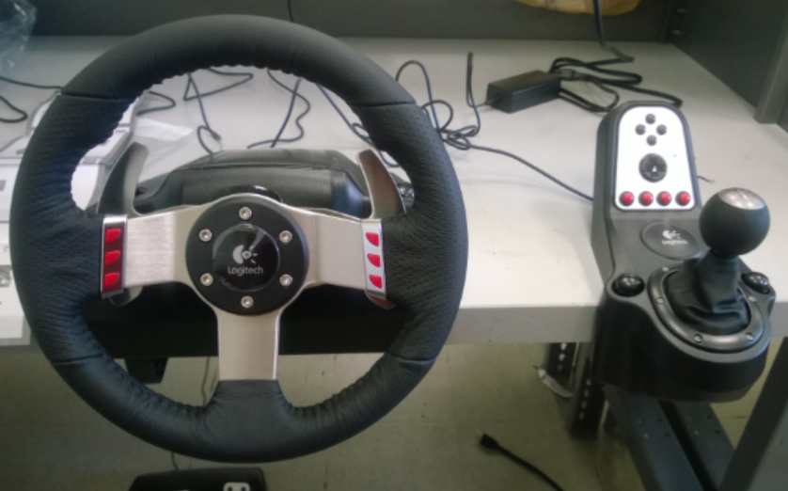
Design Decisions
Input device
Logitech G27 Racing Wheel
Sturdy and comfortable
Haptic Feedback to increase immersion

Slide 6



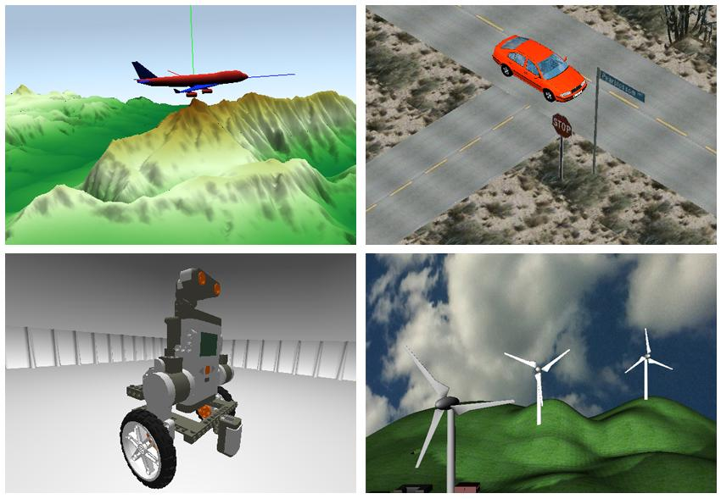
Design Decisions
Visualization software
CarSim
Unreal
Unity 3D
rFactor
MATLAB/Simulink 3D Animation
Our final choice
http://b.joaoubaldo.com/wp-content/uploads/rfactor.logo_.png
http://samueljustice.net/wp-content/uploads/2011/04/udk_logo.png
http://zigfu.com/static/img/unity.png
http://www.mathworks.com/cmsimages/58961_wl_sm_3danim_fig1_wl.jpg

Slide 7
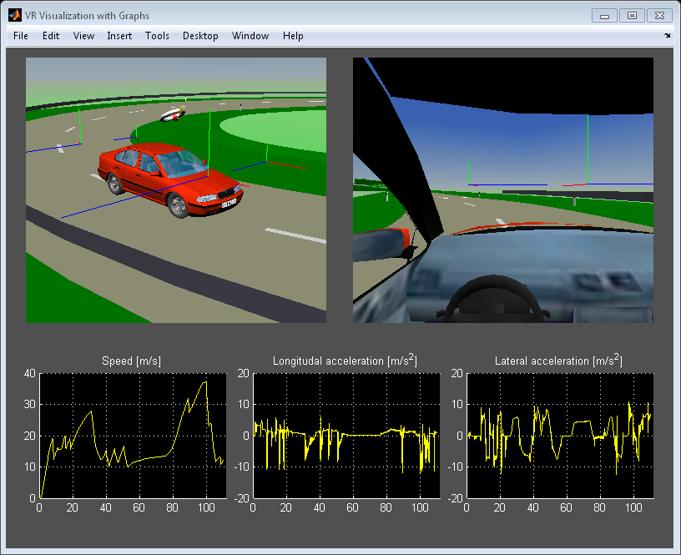
Tasks to do
Presentation for meeting with Volkswagen
Work with Simulink 3D Animation to visualize world.
Connect Logitech G27 controller inputs to Matlab vehicle model.
http://www.mathworks.nl/help/releases/R2013b/sl3d/examples/vr_octavia_graphs_02.png

Slide 8
Project Complications
Expectations
We came into the project assuming that the predictive correction software was already developed
Software
Due to difficulty deciding on which software to use, we have not had much time to develop in a single system.
Driving simulation solely in Matlab is uncommon.

Slide 9
Questions?

